Slide 1
1
Writing Basic
SQL SELECT Statements

Slide 2
Objectives
After completing this lesson, you should be able to do the following:
List the capabilities of SQL SELECT statements
Execute a basic SELECT statement
Differentiate between SQL statements and
iSQL*Plus commands
1-2
Badgujar Dipak D

Slide 3

Capabilities of SQL SELECT Statements
Projection
Selection
Table 1
Table 1
Join
Table 1
Table 2
1-3
Badgujar Dipak D

Slide 4


Basic SELECT Statement
SELECT *|{[DISTINCT] column|expression [alias],...} FROM table;
SELECT identifies what columns
FROM identifies which table
1-4
Badgujar Dipak D

Slide 5

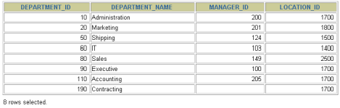
Selecting All Columns
SELECT *
FROM departments;
1-5
Badgujar Dipak D

Slide 6

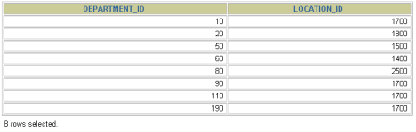
Selecting Specific Columns
SELECT
FROM departments;
department_id, location_id
1-6
Badgujar Dipak D

Slide 7
Writing SQL Statements
SQL statements are not case sensitive.
SQL statements can be on one or more lines.
Keywords cannot be abbreviated or split across lines.
Clauses are usually placed on separate lines.
Indents are used to enhance readability.
1-7
Badgujar Dipak D

Slide 8
Column Heading Defaults
iSQL*Plus:
Default heading justification: Center
Default heading display: Uppercase
SQL*Plus:
Character and Date column headings are left- justified
Number column headings are right-justified
Default heading display: Uppercase
1-8
Badgujar Dipak D

Slide 9
Arithmetic Expressions
Create expressions with number and date data by using arithmetic operators.
Operator Description
+ Add
- Subtract
* Multiply
/ Divide
1-9
Badgujar Dipak D

Slide 10



Using Arithmetic Operators
SELECT last_name, salary, FROM employees;
salary + 300
…
1-10
Badgujar Dipak D

Slide 11






Operator Precedence
* / +
_
Multiplication and division take priority over addition and subtraction.
Operators of the same priority are evaluated from left to right.
Parentheses are used to force prioritized evaluation and to clarify statements.
1-11
Badgujar Dipak D

Slide 12



Operator Precedence
SELECT last_name, salary, FROM employees;
12*salary+100
…
1-12
Badgujar Dipak D

Slide 13



Using Parentheses
SELECT last_name, salary, FROM employees;
12*(salary+100)
…
1-13
Badgujar Dipak D

Slide 14

Defining a Null Value
A null is a value that is unavailable, unassigned, unknown, or inapplicable.
A null is not the same as zero or a blank space.
SELECT last_name, job_id, salary, | commission_pct
FROM employees;
…
…
1-14
Badgujar Dipak D

Slide 15

Null Values
in Arithmetic Expressions
Arithmetic expressions containing a null value evaluate to null.
SELECT last_name, | 12*salary*commission_pct
FROM employees;
…
…
1-15
Badgujar Dipak D

Slide 16
Defining a Column Alias
A column alias:
Renames a column heading
Is useful with calculations
Immediately follows the column name - there can also be the optional AS keyword between the column name and alias
Requires double quotation marks if it contains spaces or special characters or is case sensitive
1-16
Badgujar Dipak D

Slide 17




Using Column Aliases
SELECT last_name AS name, commission_pct comm FROM employees;
…
SELECT last_name "Name", salary*12 FROM employees;
"Annual Salary"
…
1-17
Badgujar Dipak D

Slide 18
Concatenation Operator
A concatenation operator:
Concatenates columns or character strings to other columns
Is represented by two vertical bars (||)
Creates a resultant column that is a character expression
1-18
Badgujar Dipak D

Slide 19

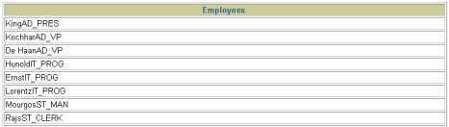
Using the Concatenation Operator
SELECT last_name||job_id AS "Employees" FROM employees;
…
1-19
Badgujar Dipak D

Slide 20
Literal Character Strings
A literal is a character, a number, or a date included in the SELECT list.
Date and character literal values must be enclosed within single quotation marks.
Each character string is output once for each row returned.
1-20
Badgujar Dipak D

Slide 21

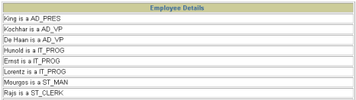
Using Literal Character Strings
SELECT last_name || | ' is a ' | ||job_id
AS "Employee Details" FROM employees;
…
1-21
Badgujar Dipak D

Slide 22


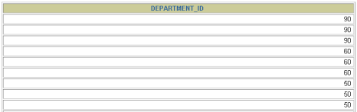
Duplicate Rows
The default display of queries is all rows, including duplicate rows.
SELECT department_id FROM employees;
…
1-22
Badgujar Dipak D

Slide 23

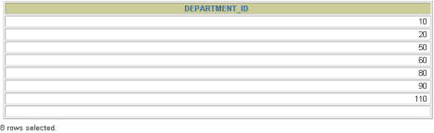
Eliminating Duplicate Rows
Eliminate duplicate rows by using the DISTINCT
keyword in the SELECT clause.
SELECT | DISTINCT | department_id
FROM employees;
1-23
Badgujar Dipak D

Slide 24

Displaying Table Structure
Use the iSQL*Plus DESCRIBE command to display the structure of a table.
DESC[RIBE] tablename
1-29
Badgujar Dipak D

Slide 25

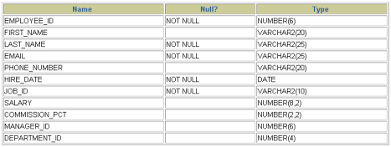
Displaying Table Structure
DESCRIBE employees
1-30
Badgujar Dipak D

Slide 26

Summary
In this lesson, you should have learned how to:
Write a SELECT statement that:
Returns all rows and columns from a table
Returns specified columns from a table
Uses column aliases to give descriptive column headings
Use the iSQL*Plus environment to write, save, and execute SQL statements and iSQL*Plus commands.
SELECT *|{[DISTINCT] column|expression [alias],...} FROM table;
1-34
Badgujar Dipak D

Slide 27
1
Restricting and Sorting Data
Badgujar Dipak D

Slide 28
Objectives
After completing this lesson, you should be able to do the following:
Limit the rows retrieved by a query
Sort the rows retrieved by a query
1-36
Badgujar Dipak D

Slide 29
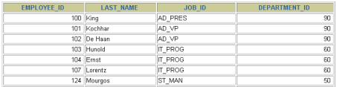

Limiting Rows Using a Selection
EMPLOYEES
…
“retrieve all employees
in department 90”
1-37
Badgujar Dipak D

Slide 30

Limiting the Rows Selected
Restrict the rows returned by using the WHERE
clause.
SELECT *|{[DISTINCT] column|expression [alias],...} FROM table
 | [WHERE condition(s)];
The WHERE clause follows the FROM clause.
1-38
Badgujar Dipak D

Slide 31


Using the WHERE Clause
SELECT employee_id, last_name, job_id, department_id FROM employees
WHERE department_id = 90
;
1-39
Badgujar Dipak D

Slide 32

Character Strings and Dates
Character strings and date values are enclosed in single quotation marks.
Character values are case sensitive, and date values are format sensitive.
The default date format is DD-MON-RR.
SELECT last_name, job_id, department_id FROM employees
WHERE last_name = | 'Whalen' | ;
1-40
Badgujar Dipak D

Slide 33
Comparison Conditions
Operator Meaning
= Equal to
Greater than
>=
Greater than or equal to
<
Less than
<=
Less than or equal to
<>
Not equal to
1-41
Badgujar Dipak D

Slide 34

Using Comparison Conditions
SELECT last_name, salary FROM employees
WHERE salary | <= 3000 | ;
1-42
Badgujar Dipak D

Slide 35
Other Comparison Conditions
Operator Meaning
BETWEEN Between two values (inclusive),
...AND...
IN(set) Match any of a list of values
LIKE Match a character pattern
IS NULL Is a null value
1-43
Badgujar Dipak D

Slide 36


Using the BETWEEN Condition
Use the BETWEEN condition to display rows based on a range of values.
SELECT last_name, salary FROM employees
WHERE salary | BETWEEN 2500 AND 3500 | ;
Lower limit
Upper limit
1-44
Badgujar Dipak D

Slide 37
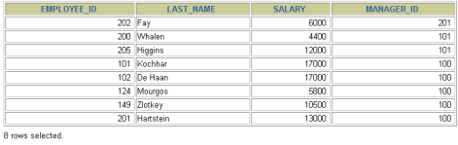
Using the IN Condition
Use the IN membership condition to test for values in a list.
SELECT employee_id, last_name, salary, manager_id FROM employees
WHERE manager_id | IN (100, 101, 201) | ;
1-45
Badgujar Dipak D

Slide 38

Using the LIKE Condition
Use the LIKE condition to perform wildcard searches of valid search string values.
Search conditions can contain either literal characters or numbers:
% denotes zero or many characters.
_ denotes one character.
SELECT first_name FROM employees
WHERE first_name | LIKE 'S%' | ;
1-46
Badgujar Dipak D

Slide 39


Using the LIKE Condition
You can combine pattern-matching characters.
SELECT last_name FROM employees
WHERE last_name | LIKE '_o%' | ;
You can use the ESCAPE identifier to search for the actual % and _ symbols.
1-47
Badgujar Dipak D

Slide 40

Using the NULL Conditions
Test for nulls with the IS NULL operator.
SELECT last_name, manager_id FROM employees
WHERE | manager_id IS NULL | ;
1-48
Badgujar Dipak D

Slide 41
Logical Conditions
Operator
Meaning
AND
Returns TRUE if both component conditions are true
OR
Returns TRUE if either component condition is true
NOT
Returns TRUE if the following condition is false
1-49
Badgujar Dipak D

Slide 42


Using the AND Operator
AND requires both conditions to be true.
SELECT employee_id, last_name, job_id, salary FROM employees
WHERE AND | salary >=10000 job_id LIKE '%MAN%' | ;
1-50
Badgujar Dipak D

Slide 43


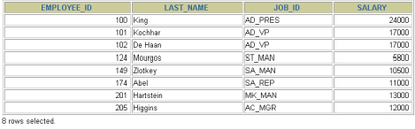
Using the OR Operator
OR requires either condition to be true.
SELECT employee_id, last_name, job_id, salary FROM employees
WHERE OR | salary >= 10000 job_id LIKE '%MAN%' | ;
1-51
Badgujar Dipak D

Slide 44

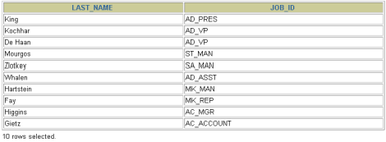
Using the NOT Operator
SELECT last_name, job_id FROM employees
WHERE job_id
NOT IN ('IT_PROG', 'ST_CLERK', 'SA_REP');
1-52
Badgujar Dipak D

Slide 45


Rules of Precedence
SELECT last_name, job_id, salary FROM employees
WHERE job_id = 'SA_REP' OR job_id = 'AD_PRES' AND salary > 15000;
1-54
Badgujar Dipak D

Slide 46
Rules of Precedence
Order Evaluated | Operator
1 | Arithmetic operators
2 | Concatenation operator
3 | Comparison conditions
4 | IS [NOT] NULL, LIKE, [NOT] IN
5 | [NOT] BETWEEN
6 | NOT logical condition
7 | AND logical condition
8 | OR logical condition
Override rules of precedence by using parentheses.
1-53
Badgujar Dipak D

Slide 47


Rules of Precedence
Use parentheses to force priority.
SELECT last_name, job_id, salary FROM employees
WHERE (job_id = 'SA_REP' OR job_id = 'AD_PRES') AND salary > 15000;
1-55
Badgujar Dipak D

Slide 48


ORDER BY Clause
Sort rows with the ORDER BY clause
ASC: ascending order, default
DESC: descending order
The ORDER BY clause comes last in the SELECT
statement.
SELECT last_name, job_id, department_id, hire_date
FROM employees
;
ORDER BY hire_date
…
1-56
Badgujar Dipak D

Slide 49

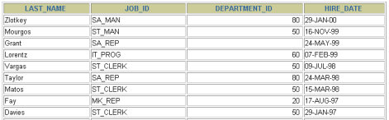
Sorting in Descending Order
SELECT last_name, job_id, department_id, hire_date FROM employees
ORDER BY hire_date | DESC | ;
…
1-57
Badgujar Dipak D

Slide 50

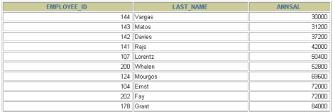
Sorting by Column Alias
SELECT employee_id, last_name, salary*12 | annsal
FROM employees ORDER BY annsal;
…
1-58
Badgujar Dipak D

Slide 51

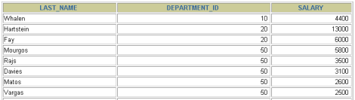
Sorting by Multiple Columns
The order of ORDER BY list is the order of sort.
SELECT last_name, department_id, salary FROM employees
 | ORDER BY department_id, salary DESC | ;
…
You can sort by a column that is not in the
SELECT list.
1-59
Badgujar Dipak D

Slide 52

Summary
In this lesson, you should have learned how to:
Use the WHERE clause to restrict rows of output
Use the comparison conditions
Use the BETWEEN, IN, LIKE, and NULL conditions
Apply the logical AND, OR, and NOT operators
Use the ORDER BY clause to sort rows of output
SELECT FROM
*|{[DISTINCT] column|expression [alias],...}
table
[WHERE condition(s)]
[ORDER BY {column, expr, alias} [ASC|DESC]];
1-60
Badgujar Dipak D

